Slide 1
TDD - Volamus
Lena Spitz, Lars Haider, Mareen Allgaier

Slide 2
Project Overview
Team
Game Concept
Technical Goals
Technical Risks
Development Environment
System

Slide 3
Game Play
Game Structrue / Game Objects
Physics
Player Actions
Victory Conditions

Slide 4
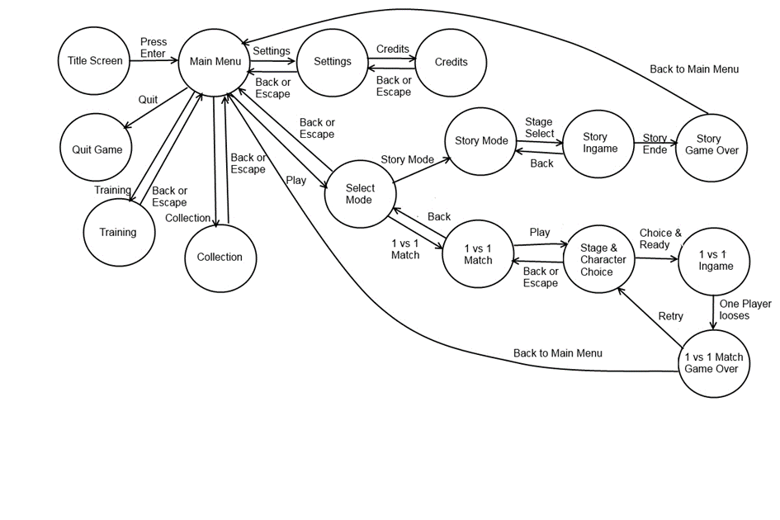
User Interface
Game Menus

Slide 5
Graphics
Features
View Modes
Schlageffekte
Bump Mapping
Sound

Slide 6
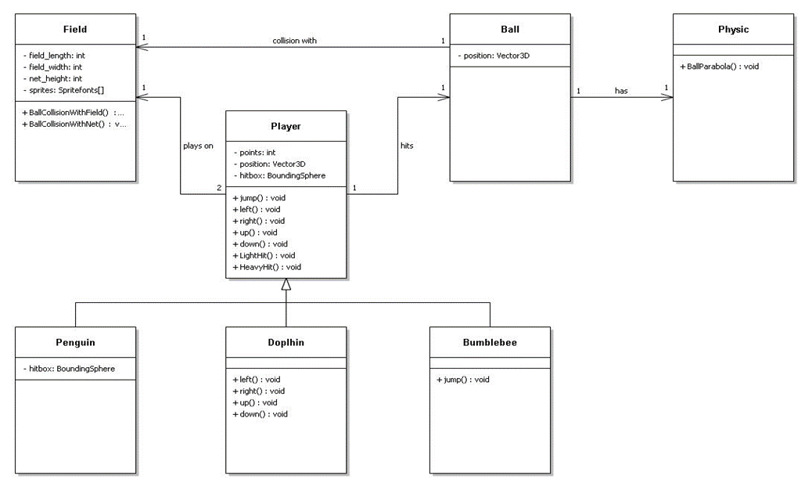
Klassen

Slide 7
Milestones & Project Management
 | Meilenstein II | Meilenstein III | Semesterferien
Lena Spitz | Modelle, Kollision | Modelle, Optimierung | Modelle + Animation, Feinschliff
Lars Haider | (Game States), Bewegungen, Kollision | Game States, Optimierung | Sounds, Feinschliff
Mareen Allgaier | Flugbahn des Balls, Kollision | Physics, Optimierung | Menüdesign, Feinschliff

